Slide 1


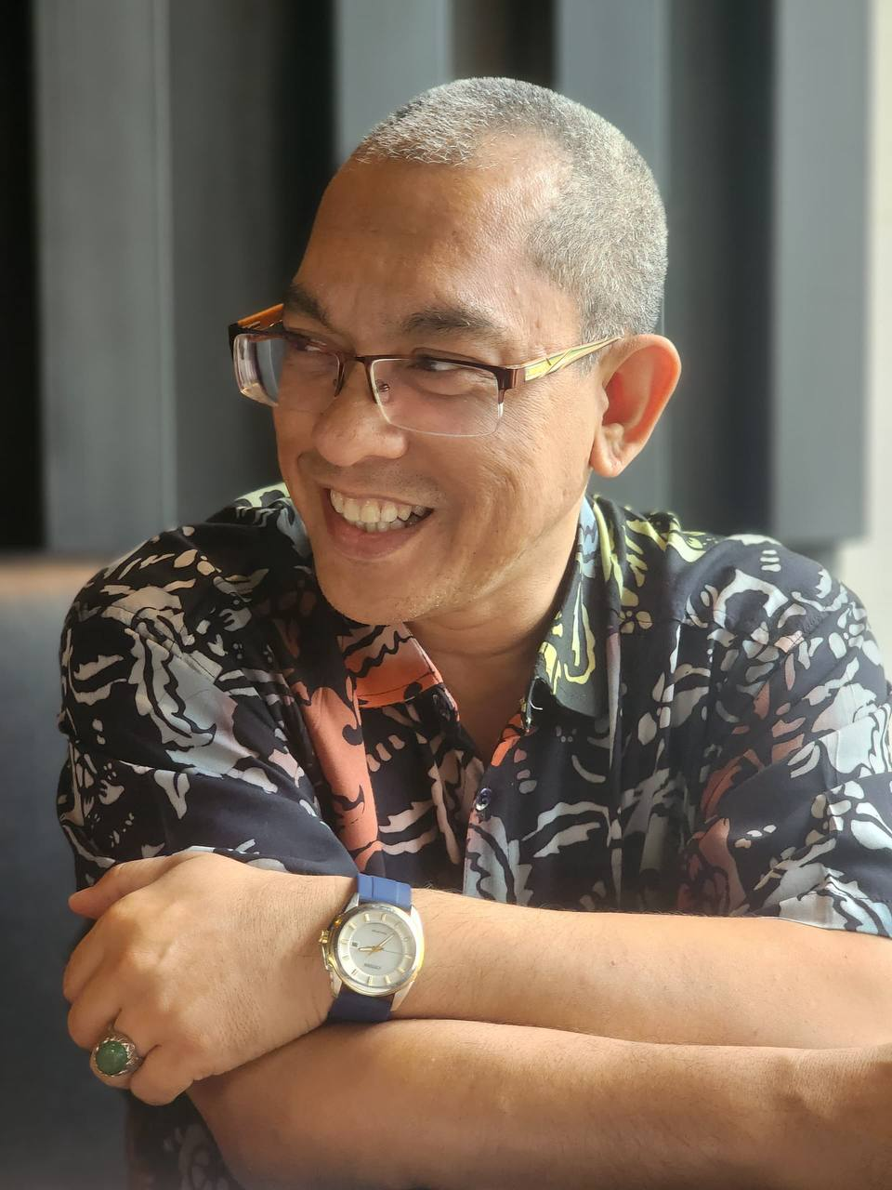
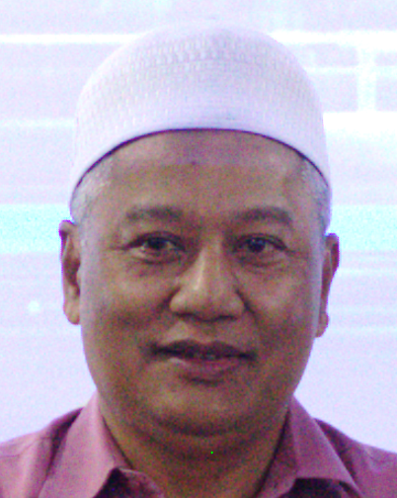
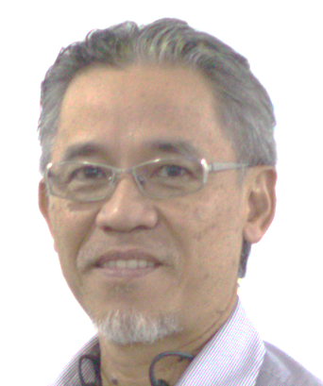
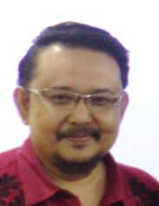
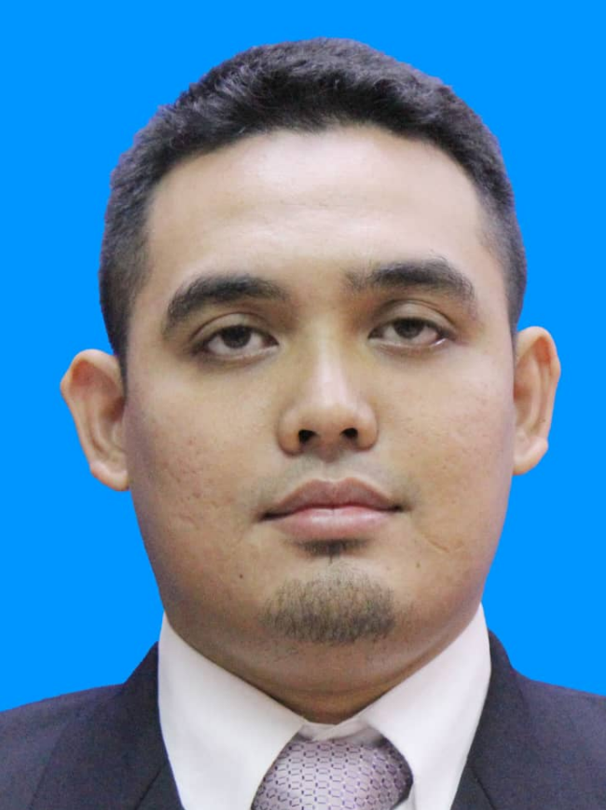
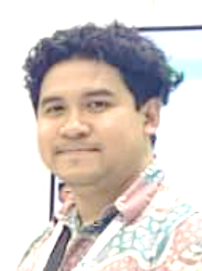
OUR TEAM - MANAGEMENT
MD SHAHZAR
Managing
Partner
ROMLI MOHD
Managing Partner
EFANDI RAMLI
Chief Technology
REMY
ABU BAKAR
Chief Operations
RIFKY KESUMA
Chief Financial
ADI
ASHRAF
Head of Technical
Page 5

Slide 2





ON-GOING PROJECT
Financial System For Schools In Selangor
Loan Management System
Digital Dashboard For Oil Production
MyDigital ID
Oil Field Rokan Hilir, Riau Resource Assessments
Oil Field Development For Pt Etam Lestari, Indonesia
Unified communication for PERLIS State
Maintenance Support for PETRONAS
Sidoarjo Oi Production System Construction
Page 6

Slide 3
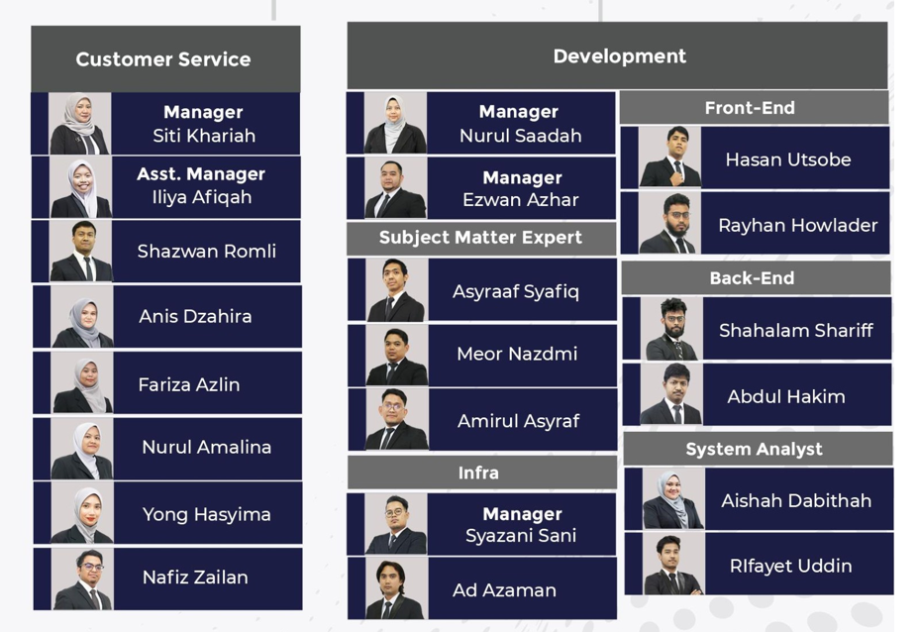
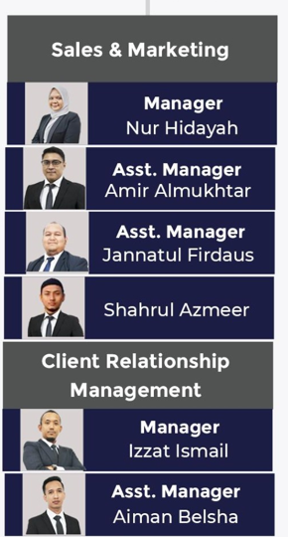
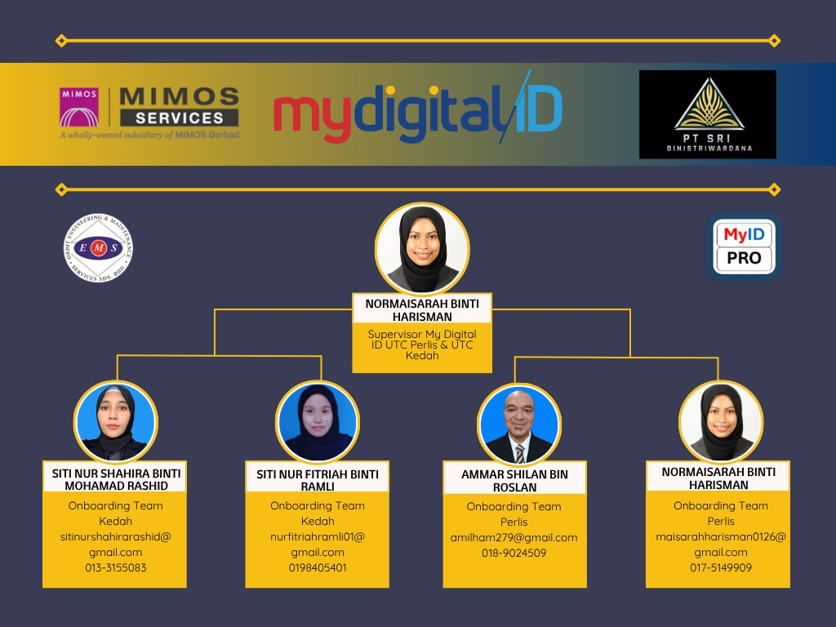
PROJECT TECHNICAL SUPPORT
DEVELOPMENT
TECHNICAL SUPPORT
ENGINEERING
Page 7

